Slide 1
Weka

Slide 2
Main Features
Weka contains tools for data pre-processing, classification, clustering, association rules, and visualization. (Weka Knowledge Explorer)
Environment for comparing learning algorithms (Experimental)
It is also well-suited for developing new data mining or machine learning schemes.

Slide 3
WEKA: versions
There are several versions of WEKA:
  WEKA 3.0: “command-line”
  WEKA 3.2: “GUI version” adds graphical user interfaces
  WEKA 3.3: “development version” with lots of improvements
  WEKA 3.8 [Stable Version]
  WEKA 3.9
This talk is based on the snapshot of WEKA 3.3

Slide 4
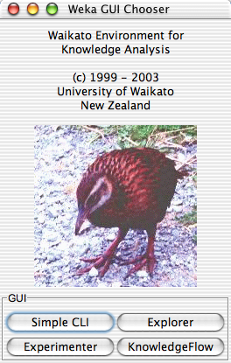
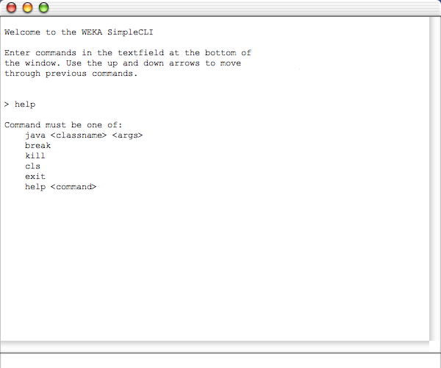
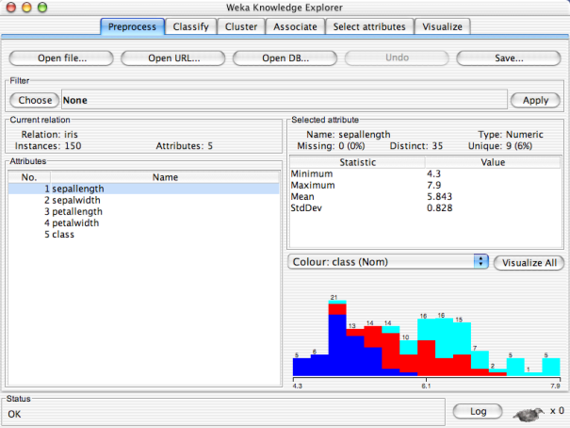
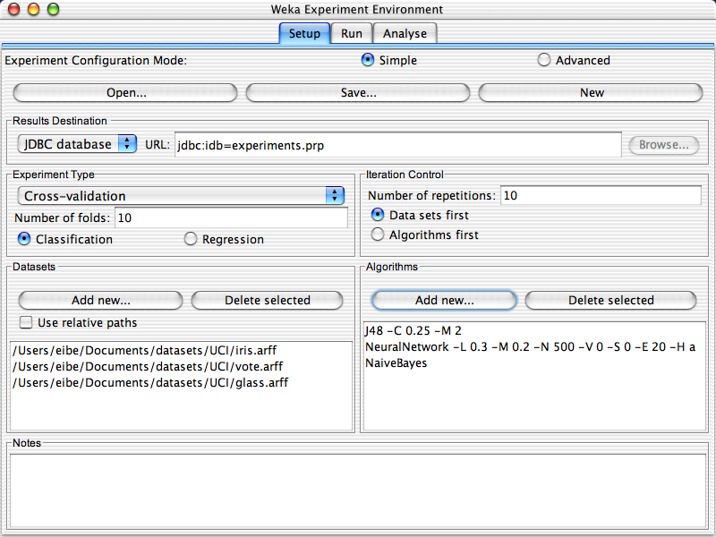

Slide 5
WEKA Knowledge Explorer
Preprocess Choose and modify the data
Classify Train and test learning schemes that classify
Cluster Learn clusters for the data
Association Learn association rules for the data
Select attributes Most relevant attributes in the data
Visualize View an interactive 2D plot of the data

Slide 6
WEKA Explorer: Pre-processing the Data
Data can be imported from a file in various formats: ARFF, CSV, C4.5, binary
Data can also be read from a URL or from an SQL database (using JDBC)
Pre-processing tools in WEKA are called “filters”
WEKA contains filters for:
  Discretization, normalization, attribute selection, transforming, …

Slide 7
WEKA only deals with “flat” files
The data must be converted to ARFF format before applying any algorithm.
  The dataset’s name: @relation
  The attribute information: @attribute
  The data section begins with @data
  Data: a list of instances with the attribute values being separated by commas.
  By default, the class is the last attribute in the ARFF file.

Slide 8
Numeric attribute and Missing Value
@relation weather
@attribute outlook {sunny, overcast, rainy}
@attribute temperature numeric
@attribute humidity numeric
@attribute windy {TRUE,FASE}
@attribute play {YES,NO}
@data
Sunny, 85, 85, FALSE, no
Sunny, 80, 90, TRUE, no
Overcast, 83, 86, FALSE, yes
Rainy, 70, 96, FALSE, yes
...
The dataset’s name
The attribute information
Data

Slide 9
Numeric attribute and Missing Value
@relation weather
@attribute outlook {sunny, overcast, rainy}
@attribute temperature numeric
@attribute humidity numeric
@attribute windy {TRUE,FASE}
@attribute play {YES,NO}
@data
Sunny, 85, 85, FALSE, no
Sunny, 80, 90, TRUE, no
Overcast, 83, 86, FALSE, ?
Rainy, 70, 96, ?, yes
...
numeric attribute
nominal attribute
Missing Value

Slide 10
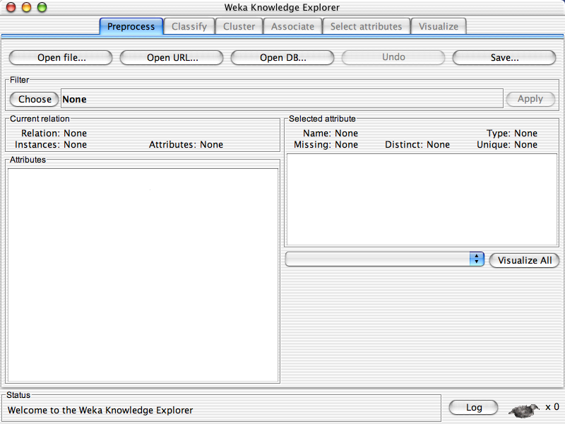

Slide 11
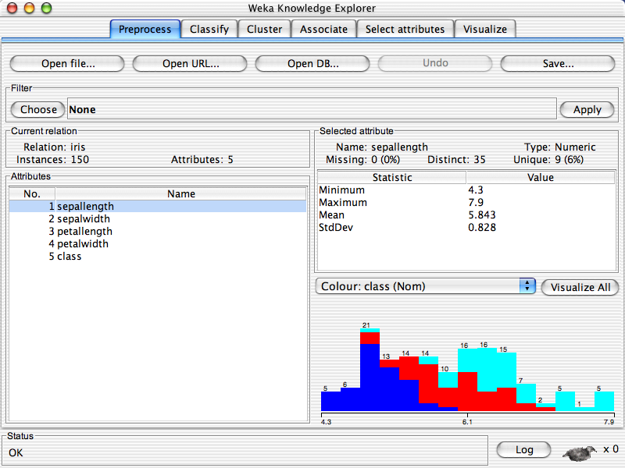

Slide 12
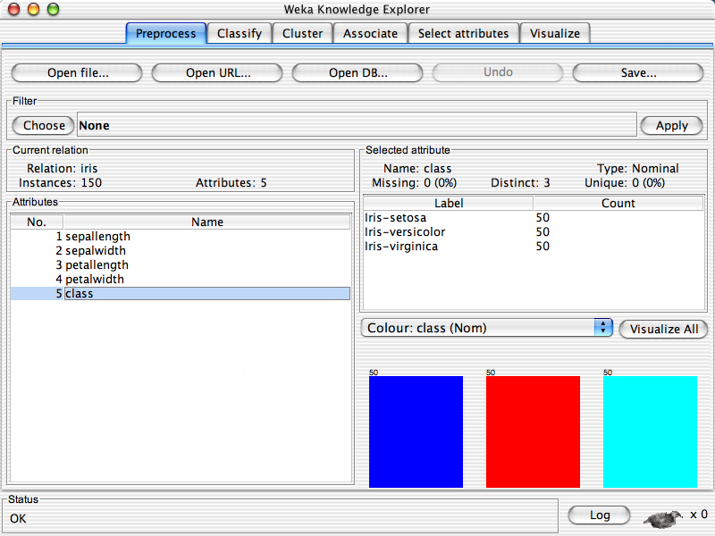

Slide 14
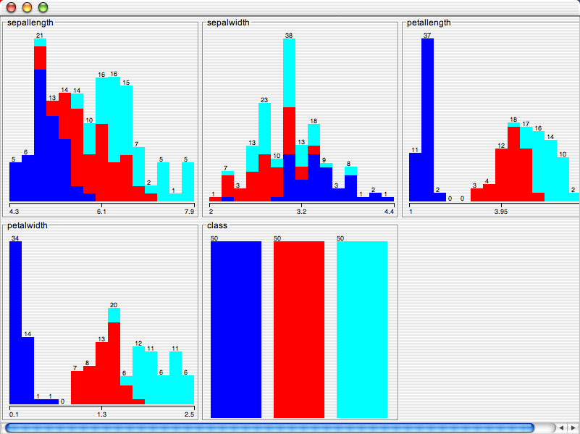

Slide 15
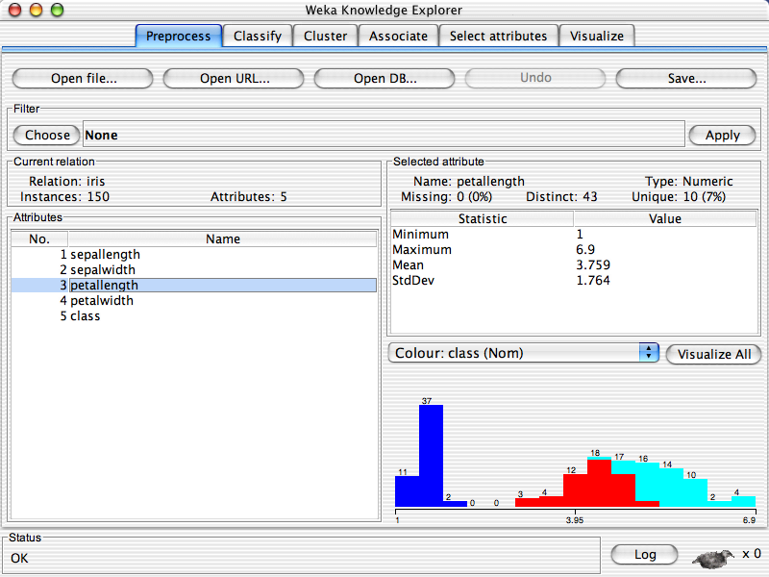

Slide 16
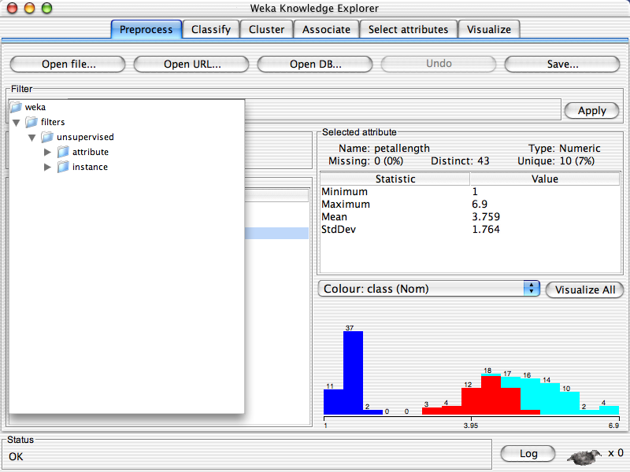

Slide 18
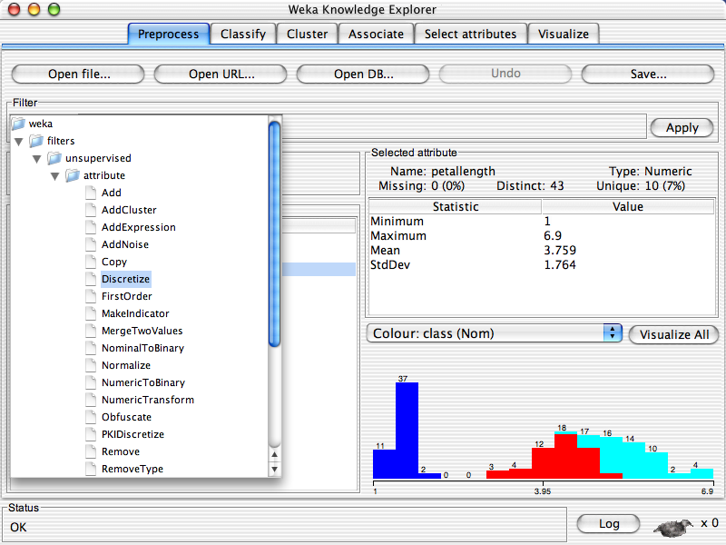

Slide 19
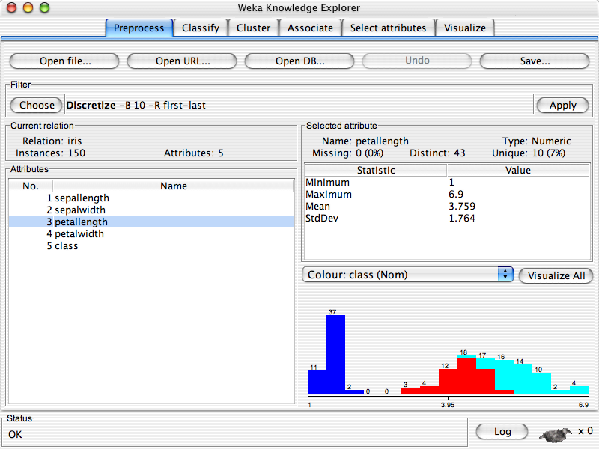

Slide 20


Slide 21
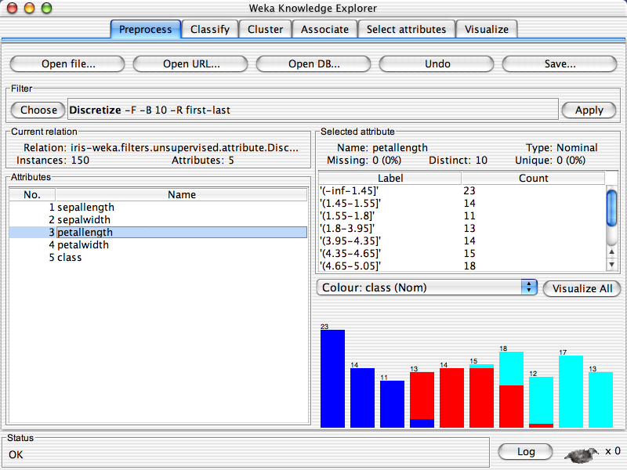

Slide 22
Explorer: building “classifiers”
Classifiers in WEKA are models for predicting nominal or numeric quantities
Implemented learning schemes include:
  Decision trees and lists, instance-based classifiers, support vector machines, multi-layer perceptrons, logistic regression, Bayes’ nets, …

Slide 23
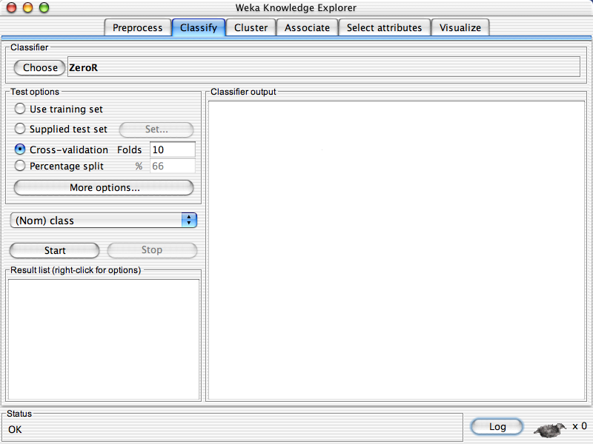

Slide 24
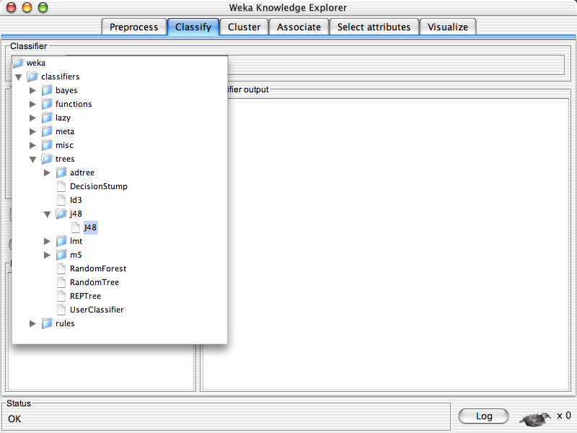

Slide 25
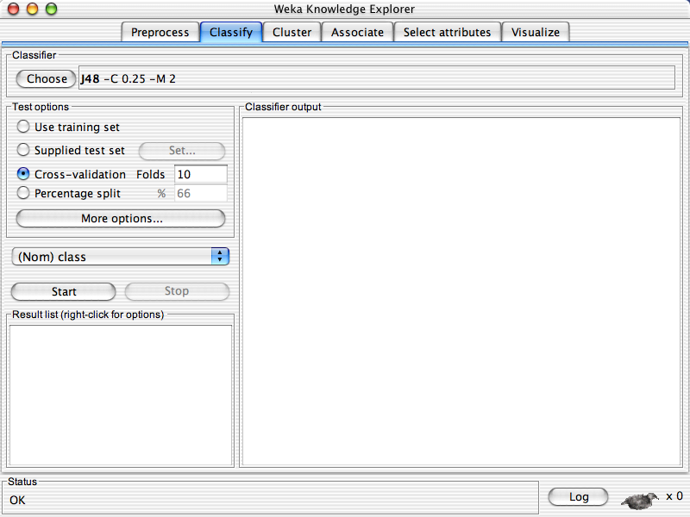

Slide 26
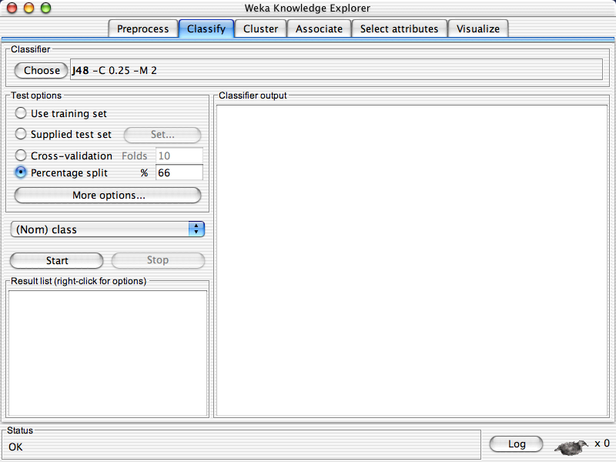

Slide 28
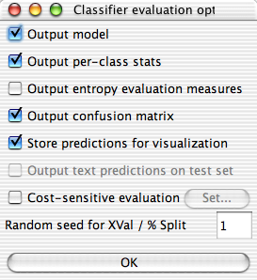

Slide 30
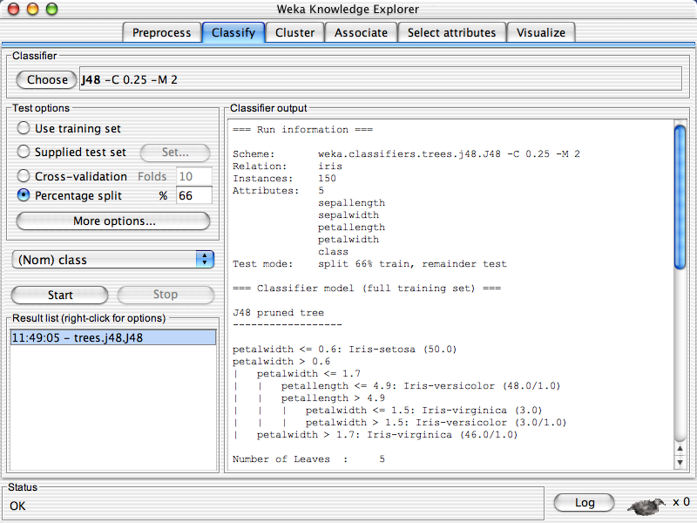

Slide 31
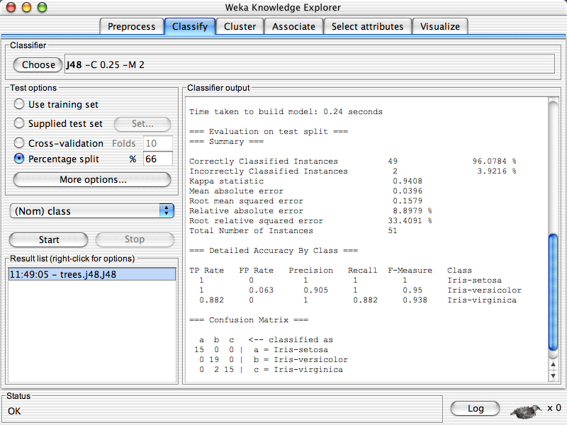

Slide 32
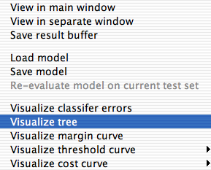

Slide 33
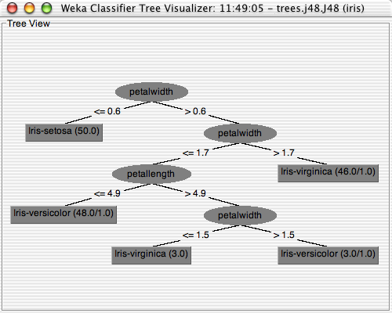

Slide 34
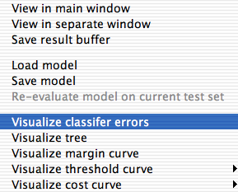

Slide 35
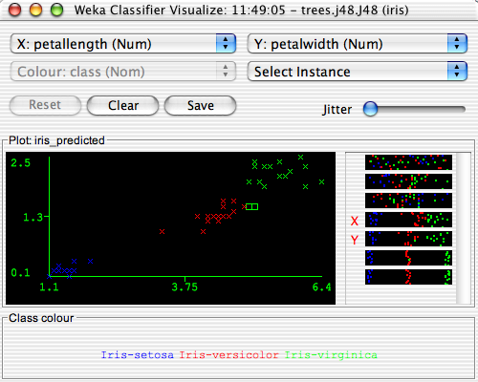

Slide 37
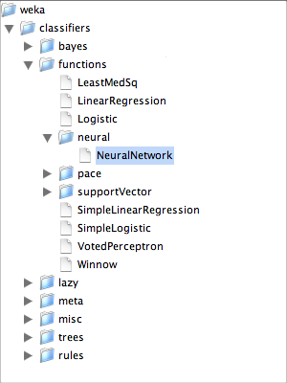

Slide 38
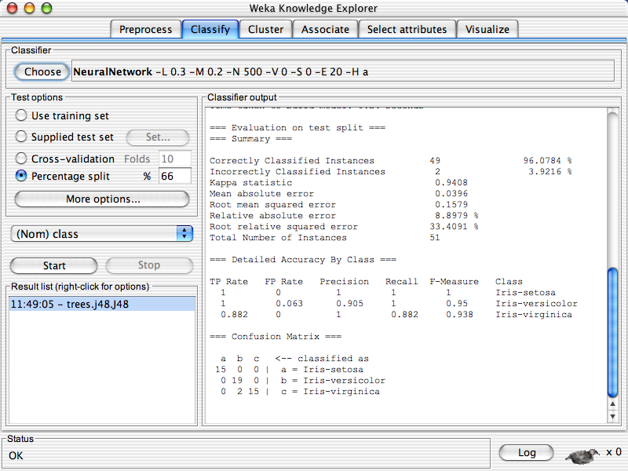

Slide 40
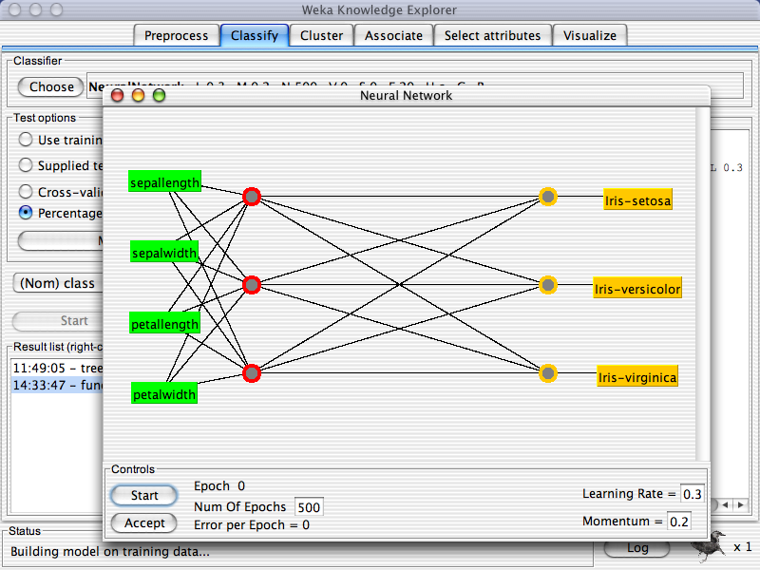
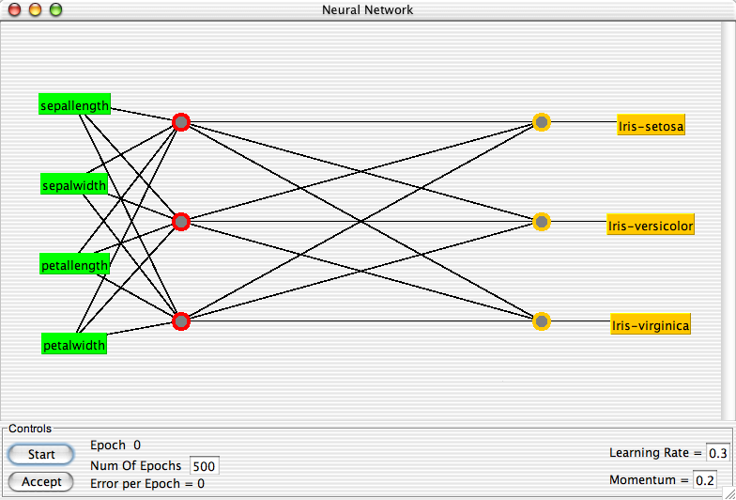

Slide 42
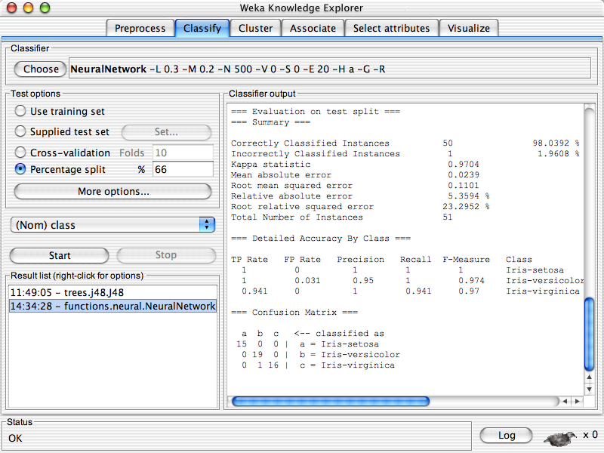

Slide 44
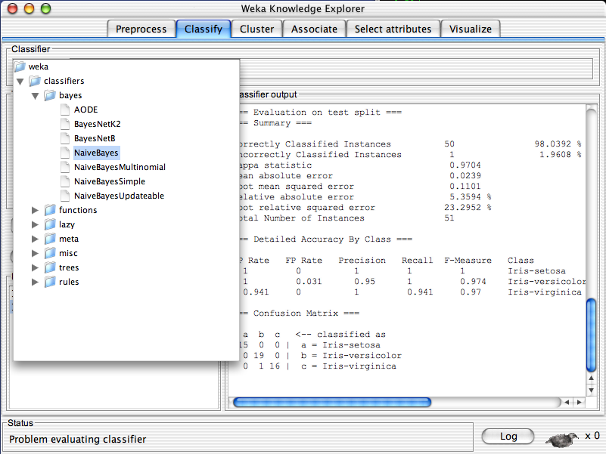
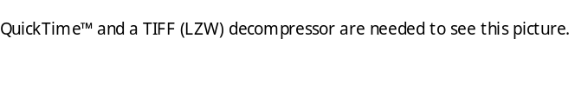

Slide 45
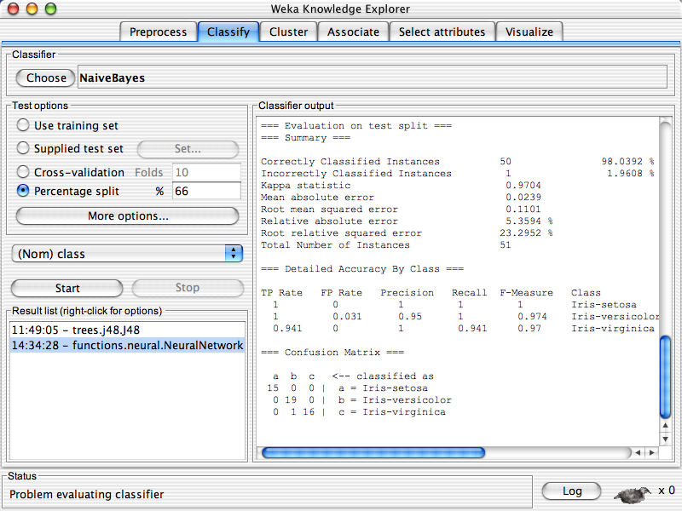

Slide 47
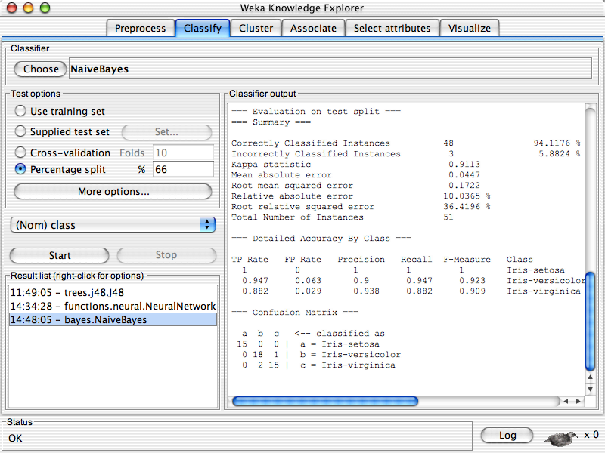

Slide 48
Explorer: clustering data
WEKA contains “clusterers” for finding groups of similar instances in a dataset
Implemented schemes are:
  k-Means, EM, Cobweb, X-means, FarthestFirst
Clusters can be visualized
Evaluation based on loglikelihood if clustering scheme produces a probability distribution

Slide 49
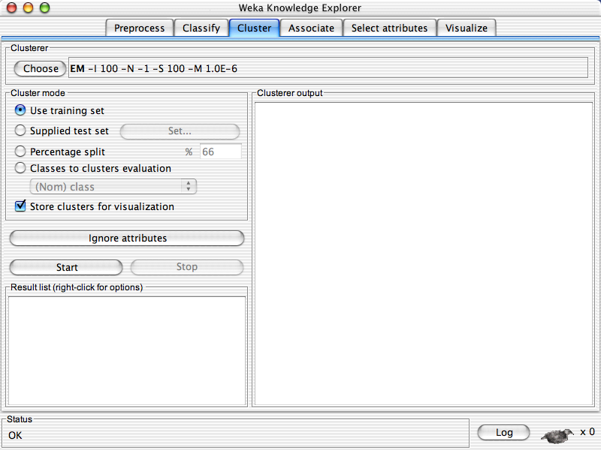

Slide 50
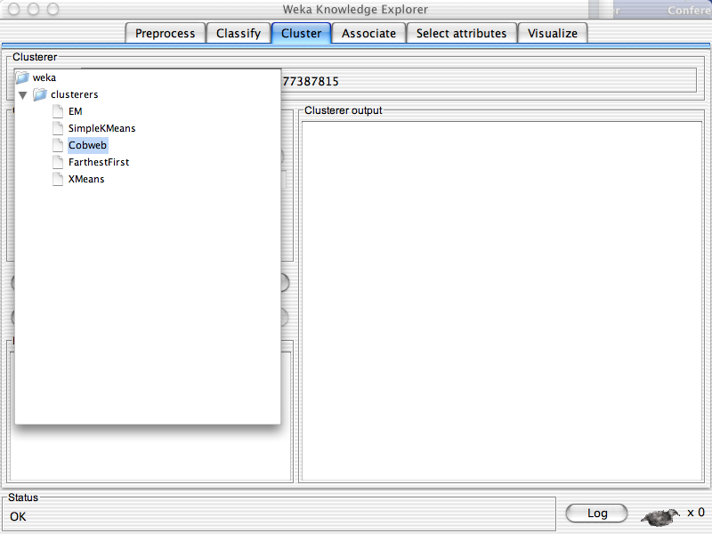

Slide 51
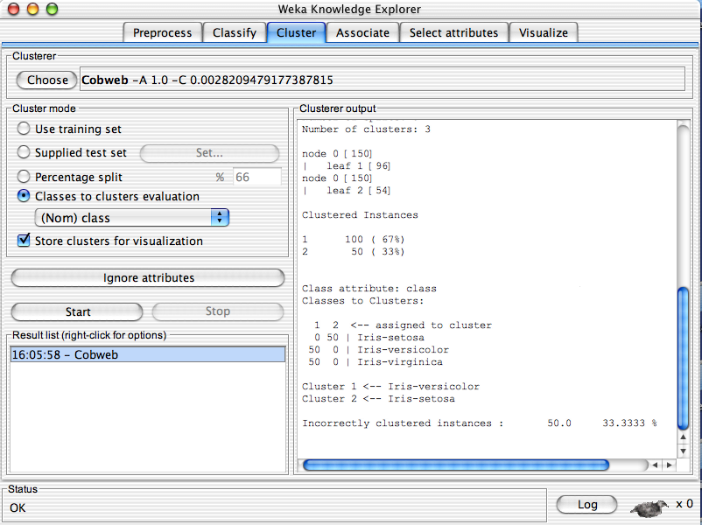

Slide 52
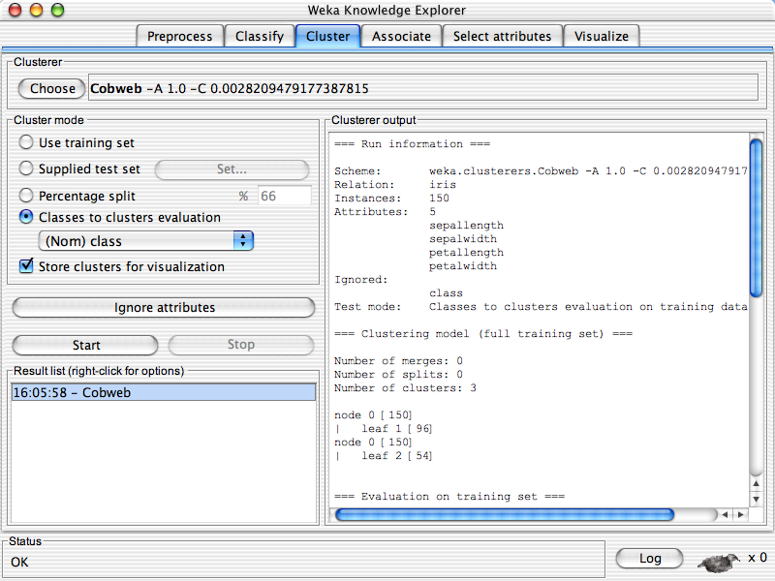
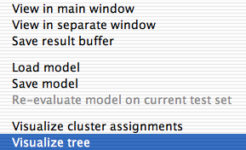

Slide 53
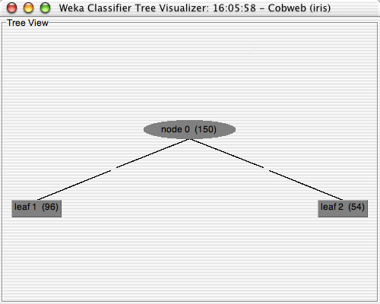

Slide 54
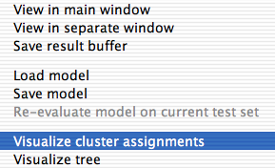

Slide 55
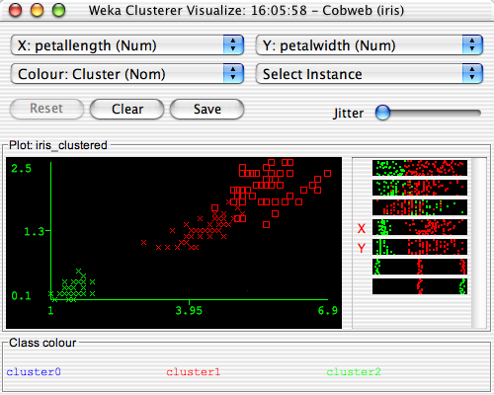

Slide 56
Explorer: finding associations
WEKA contains an implementation of the Apriori algorithm for learning association rules
  Works only with discrete data
Can identify statistical dependencies between groups of attributes:
  milk, butter ⇒ bread, eggs (with confidence 0.9)
Apriori can compute all rules that have a given minimum support and exceed a given confidence

Slide 57
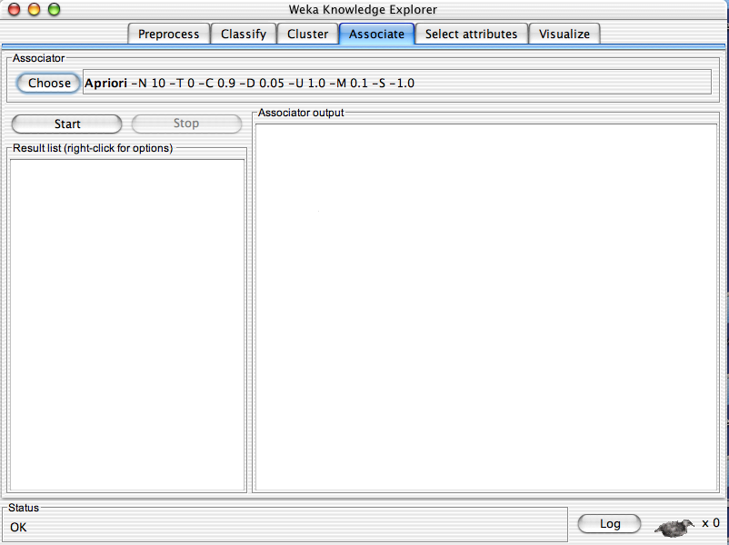

Slide 58
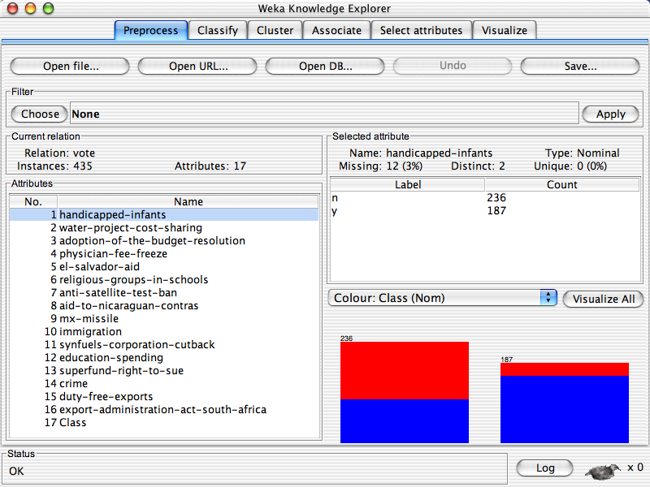

Slide 61
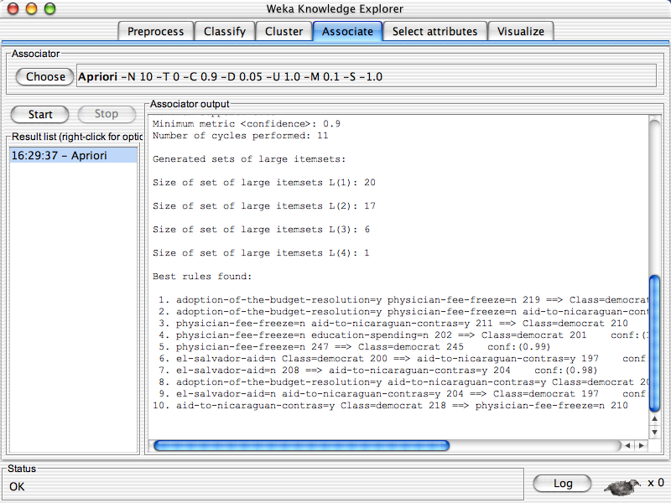

Slide 62
Explorer: attribute selection
Panel that can be used to investigate which (subsets of) attributes are the most predictive ones
Attribute selection methods contain two parts:
  A search method: best-first, forward selection, random, exhaustive, genetic algorithm, ranking
  An evaluation method: correlation-based, wrapper, information gain, chi-squared, …
Very flexible: WEKA allows (almost) arbitrary combinations of these two

Slide 63
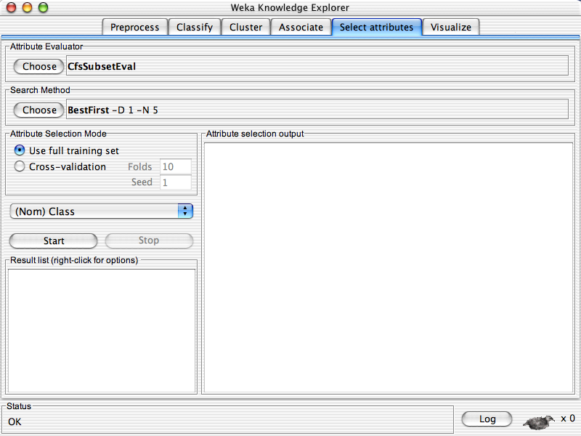

Slide 64
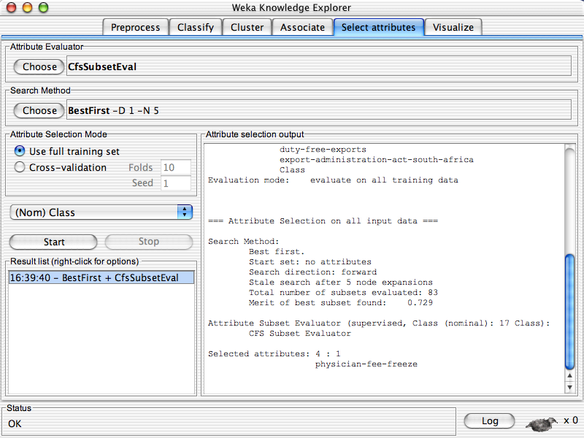

Slide 65
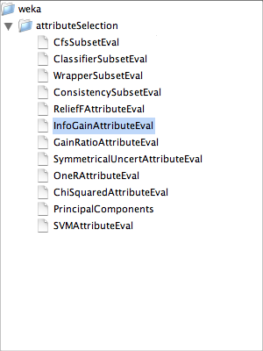

Slide 66
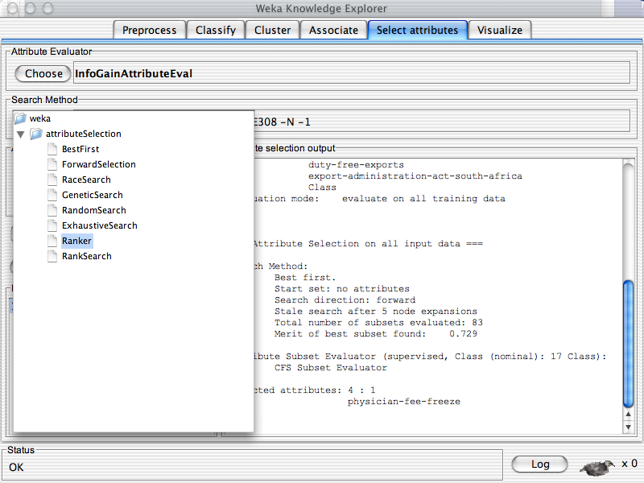

Slide 67
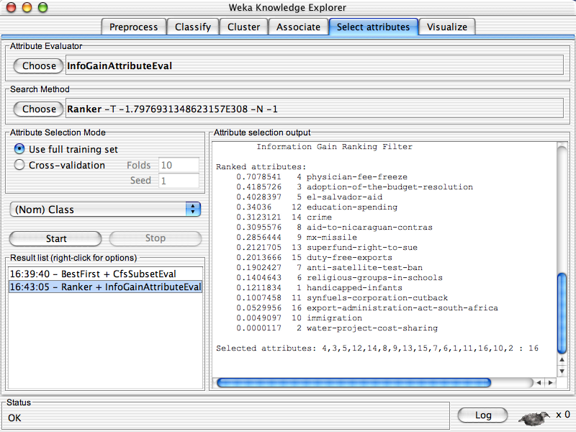

Slide 68
Explorer: data visualization
Visualization very useful in practice: e.g. helps to determine difficulty of the learning problem
WEKA can visualize single attributes (1-d) and pairs of attributes (2-d)
  To do: rotating 3-d visualizations (Xgobi-style)
Color-coded class values
“Jitter” option to deal with nominal attributes (and to detect “hidden” data points)

Slide 69
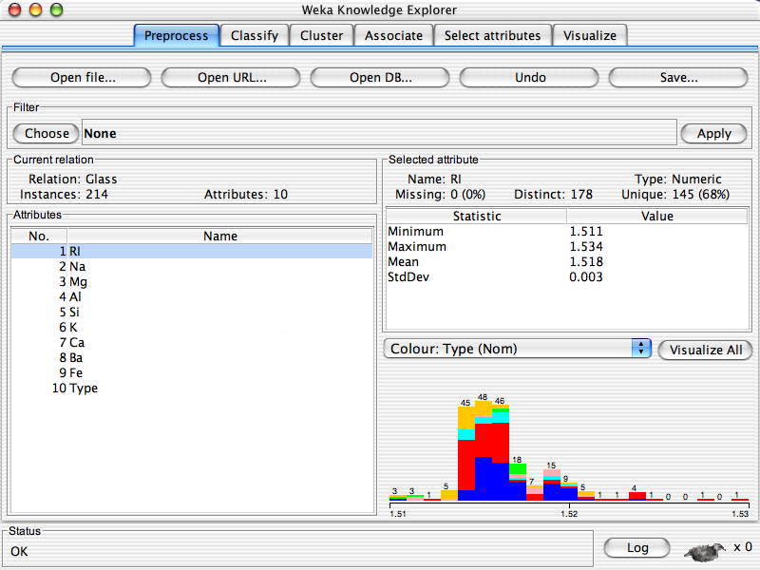

Slide 70


Slide 71


Slide 72


Slide 73


Slide 75
Performing experiments
Experimenter makes it easy to compare the performance of different learning schemes
For classification and regression problems
Results can be written into file or database
Evaluation options: cross-validation, learning curve

Slide 76


Slide 79


Slide 80


Slide 82


Slide 83


Slide 84
Resources:
WEKA is available at
http://www.cs.waikato.ac.nz/ml/weka
List of projects based on WEKA
Tutorial.
http://prdownloads.sourceforge.net/weka/weka.ppt

